Slide 1

BAPUJI EDUCATIONAL ASSIOCIATION® BAPUJI INSTITUTE OF ENINEERING AND TECHNOLOGY,DAVANGERE-577004 DEPARTMENT OF ELECTRONICS AND COMMUNICATION ENINEERING
Mini Project Presentation
On
GARBAGE MONITORING AND CONTROLLING WITH SMART SEGREGATION OF DRY AND WET
WASTE
Mini Project Associates
S SUHAS 4BD20EC060
SHREYAS P 4BD20EC066
VYSHNAVI H K 4BD20EC090
CHITRA A 4BD21EC408
Dr. PRAKASH K M Dr. G S SUNITHA
B.E(E&CE), M. Tech(DEAC), Ph.D
M. Tech(DEAC), Ph. D, MISTE, FIETE,FIE
MINI PROJECT GUIDE
PROGRAM COORDINATOR

Slide 2
VISION OF THE DEPARTMENT
To be in the forefront in providing quality technical education and research in Electronics & Communication Engineering to produce skilled professionals to cater to the challenges of the society.
MISSION OF THE DEPARTMENT
1. To facilitate the students with profound technical knowledge through effective teaching .....learning process for a successful career.
2. To impart quality education to strengthen students to meet the industry standards and ….face confidently the challenges in the programme.
3. To develop the essence of innovation and research among students and faculty by ….providing infrastructure and a conducive environment.
4. To inculcate the student community with ethical values, communication skills, …..leadership qualities, entrepreneurial skills and lifelong learning to meet the societal ….needs.

Slide 3
Course Learning Objectives (18ECMP68)
This course will enable us to:
Understand and analyze an engineering problem.
Acquire technical knowledge and collect the information.
Report Enhance communication, technical presentation and preparation skills and
innovative ideas.
Provide an opportunity to exercise the creative in group.

Slide 4
Contents
Introduction
Objectives
Block diagram of the project
Hardware requirements
Software requirements
Methodology
Flow chart
Advantages
Applications
Result
Conclusion
References

Slide 5
Introduction
The amount of waste has been increasing due to the increase in human population and urbanization.
In cities, the overflowed bin creates an unhygienic environment. Thus degrades the environment, to overcome this situation Garbage monitoring and controlling with smart segregation of dry and wet waste is developed to reduce to work for the ragpickers, the wastes are segregated by the human beings which leads to health problems to the workers.
The proposed system separates the waste into two categories namely wet and dry.
Each of the waste is detected by the respective sensors and gets segregated inside the bins which is assigned to them. The details of amount of waste disposal is updated regularly.

Slide 6
Objectives
To understand about various sensors and its functionality.
To develop waste monitoring and segregation system using Arduino.
To fabricate a less complex automatic waste monitoring and segregation system.

Slide 7
Block diagram
Power supply
Arduino uno
Moisture Sensor
IR SENSOR
LCD
Servo Motor
Buzzer
Slot 1
Slot 2
Ultrasonic Sensor
Fig 1: Block Diagram

Slide 8
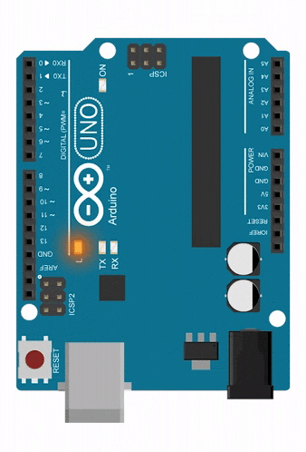
Hardware requirements
Arduino uno
The Arduino boards are equipped with 14 digital pins for input or output, and 6 analog pins for input that are used to interface different circuits.
The customization of microcontrollers is done by utilizing Embedded C and C++ programming codes.
Current Arduino boards are programmed by means of Universal Serial Bus (USB).
It is the main controlling unit.
Fig 2: Arduino UNO

Slide 9
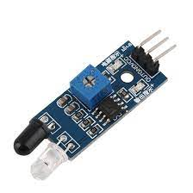
Ir Proximity SENSOR
The presence of objects is detected without any physical contact with the help of proximity sensor.
It detects objects by “emitting electromagnetic field or electromagnetic radiation and observes the changes in the field or return signal.”
Is used to detect the presence of the waste.
Fig 3: IR proximity sensor

Slide 10
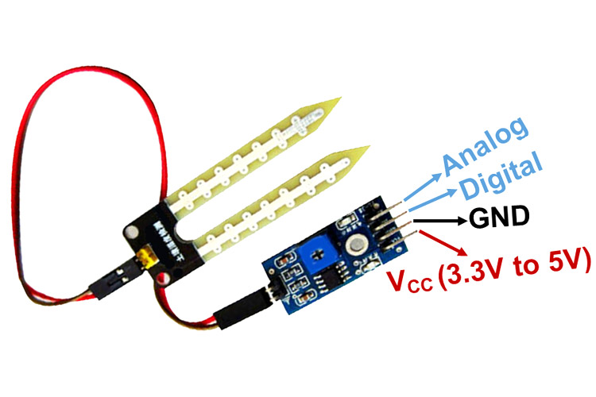
moisture sensor
It is used to identify if the garbage is wet or dry.
The content of moisture in the waste is tested and accordingly it is dropped in the appropriate dustbin.
It measures the volumetric content of water inside the waste and gives us the moisture level as output.
The module has both digital and analog outputs and a potentiometer to adjust the threshold level.
Fig 4: Moisture sensor

Slide 11
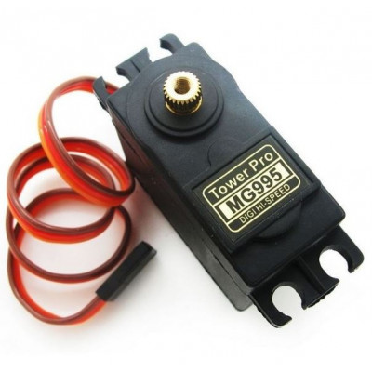
servo motor
It is used to deflect the waste to the respective bins. A servomotor is defined by “a rotary actuator or linear actuator that takes into account exact control of angular or linear position, velocity and acceleration.”
MG995 Metal Gear Servo Motor is a high-speed standard servo can rotate approximately 180 degrees (60 in each direction).
Fig 5: Servo motor

Slide 12
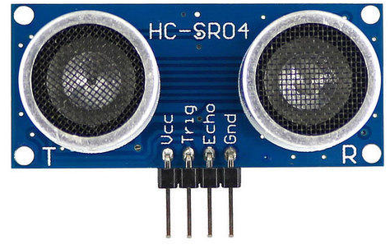
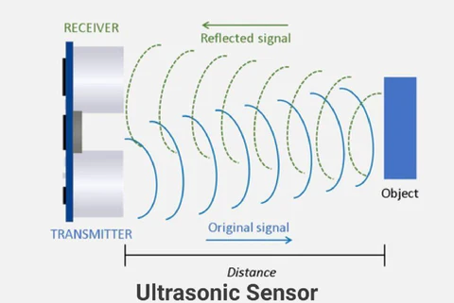
Ultrasonic sensor
It is used to keep check on the garbage level of the bin.
The acoustic Ultrasonic sensor is divided into three categories:
1. Receivers
2. Transceivers
3. Transmitters
The transmitters radiate the ultrasound by converting electrical signals into ultrasound.
It is then reflected by the obstacle and received by the receiver that converts the ultrasound into electrical signal.
The reflected signals are used to interpret the position of the garbage in the bin.
Fig 6: Ultrasonic sensor
Fig 7: working principle

Slide 13
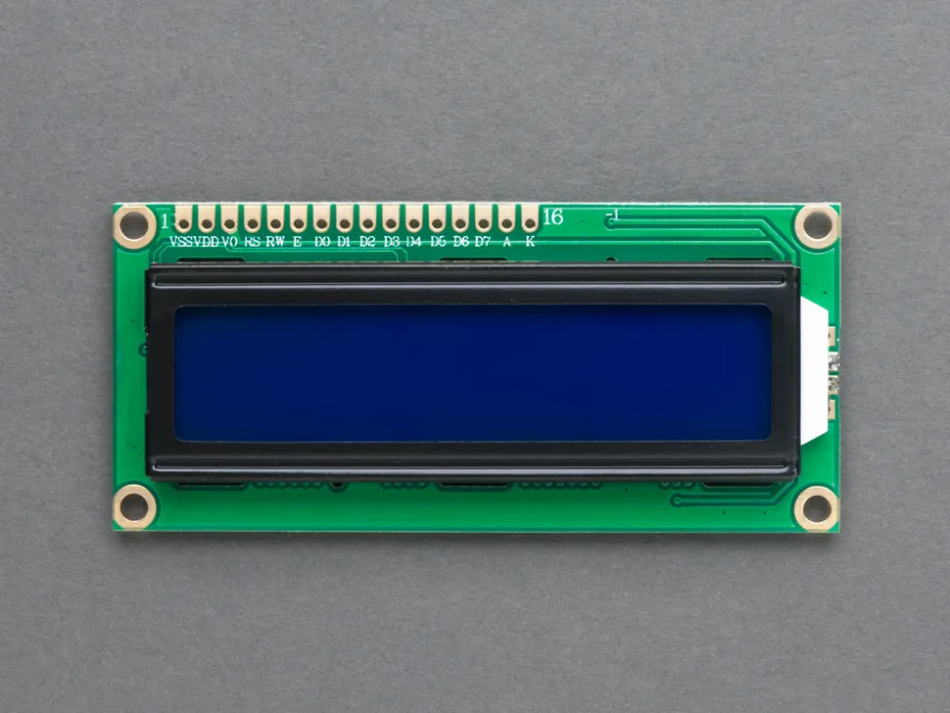
16x2 LCD display
A LCD (Liquid Crystal Display) very basic module and is very commonly used in various devices and circuits.
A 16x2 LCD means it can display 16 characters per line and there are 2 such lines. In this LCD each character is displayed in 5x7 pixel matrix.
The 16 x 2 intelligent alphanumeric dot matrix display is capable of displaying 224 different characters and symbols. This LCD has two registers, namely, Command and Data.
Used to show the level of waste in bin and indicates when bin is full.
Fig 8: LCD display

Slide 14
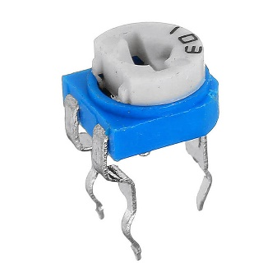
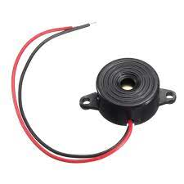
10K Potentiometer
A potentiometer is a three-terminal resistor with a sliding or rotating contact that forms an adjustable voltage divider. It is often used to regulate the current flow either by adding or subtracting resistance from the circuit.
Used to control the contrast of 16x2 LCD display.
Fig 9: 10K Potentiometer
Buzzer
The passive buzzer is an electromagnetic speaker used to generate sound signals of different frequencies when bin is full. The active buzzer is the simplest module to produce a sound of about 2 kHz .
Fig 10: Buzzer

Slide 15
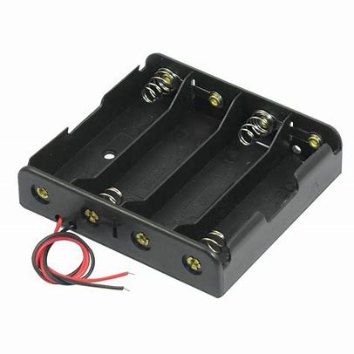
4 x AA Battery Holder Case
A 4 x AA Battery Holder case is suitable for 4 x AA batteries with spring clip design.
We can easily put the AA battery in it.
It powers the unit with AA batteries in it.
Fig 11: 4 x AA Battery Holder case

Slide 16
Software requirements
Arduino IDE
A cross platform application comprising functions that are coded in Embedded C and C++.
In this system, the program is written in Embedded C for the working of the hardware components.
The program code written on Arduino IDE was then fed to the Arduino for the working of the whole system.

Slide 17
Flow Chart
START
N
Check for waste
Y
Check for Wet waste
Y
Servo Motor rotates clock Wise 30 degree
Waste is dumped in slot 1
Measurement of level in bin
N
Servo Motor rotates anti clock wise 30 degree
Is the waste bin full?
N
Dry Waste
Y
Waste is dumped in slot 2
Y
Indicates the bin is full by Displaying and buzzing
Manually empty the bin
Fig 12: Flow chart

Slide 18
Methodology
The Automatic Waste Segregator System is driven by the Microcontroller Arduino UNO. All the components that are connected to Arduino UNO are programmed using the Arduino IDE. The program is written in Embedded C language and it reads the input/output pins of the components.
Firstly the waste is being dumped in the bin and the IR sensor senses the presence of waste.
In the presence of waste moisture sensor checks whether the waste is dry or wet.
Based on the output given by moisture sensor the waste is dumped in respective slots by servo motor.
Ultrasonic sensors are present in each slots which measures the level of bin.
In case the bin is full ultrasonic sensor detects it and LCD displays the bin is full and
buzzer buzzes.

Slide 19
Application
Residential: This systems can be used in residential areas to help residents sort their waste into different categories.
Commercial: This systems can be used in commercial areas, such as restaurants, hotels, and offices, to help businesses sort their waste.
Industrial: This systems can be used in industrial areas, such as factories and warehouses, to help businesses sort their waste.
Municipal: This systems can be used by municipalities to help manage waste collection and disposal.
When waste is properly segregated, it can be recycled or composted, which reduces the amount of waste that needs to be buried in landfills. Landfills are a major source of methane, a greenhouse gas that contributes to climate change.

Slide 20
Advantages
Reduces the amount of waste sent to landfills: By segregating waste, it can be recycled or composted, which reduces the amount of waste that ends up in landfills.
Reduces the amount of pollution from waste: When waste is not properly managed, it can pollute the air, water, and soil. By segregating waste and recycling or composting it, the amount of pollution from waste can be reduced.
Improves public health: By reducing the amount of waste that ends up in landfills, the risk of disease from contaminated waste can be reduced.
Creates jobs: The implementation of automatic waste segregation and management systems can create jobs in the waste management industry.

Slide 21
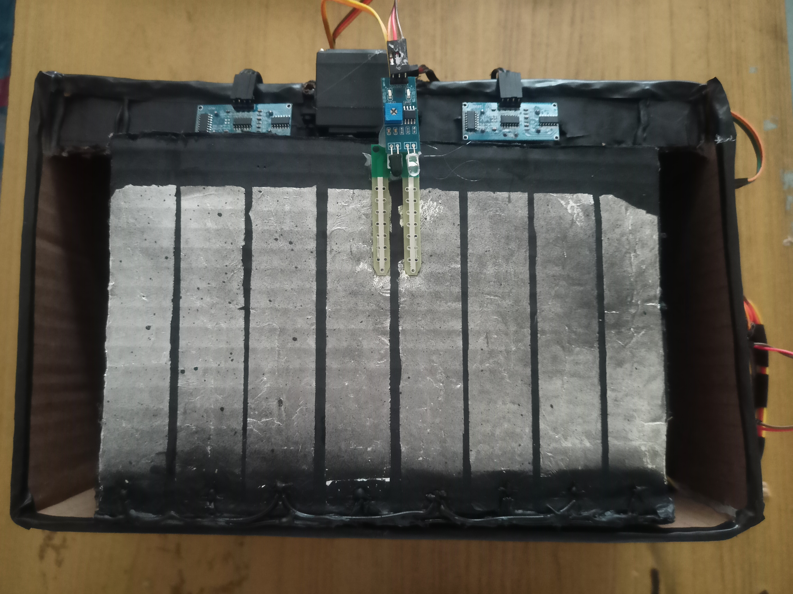
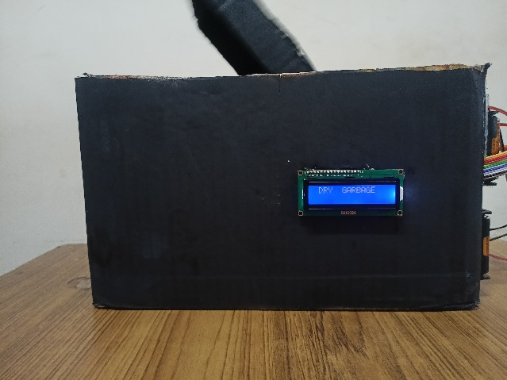
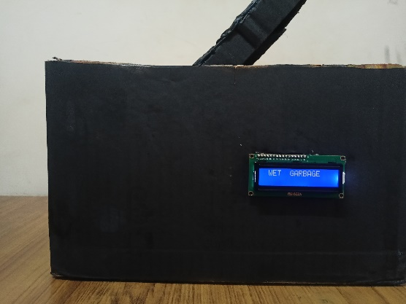
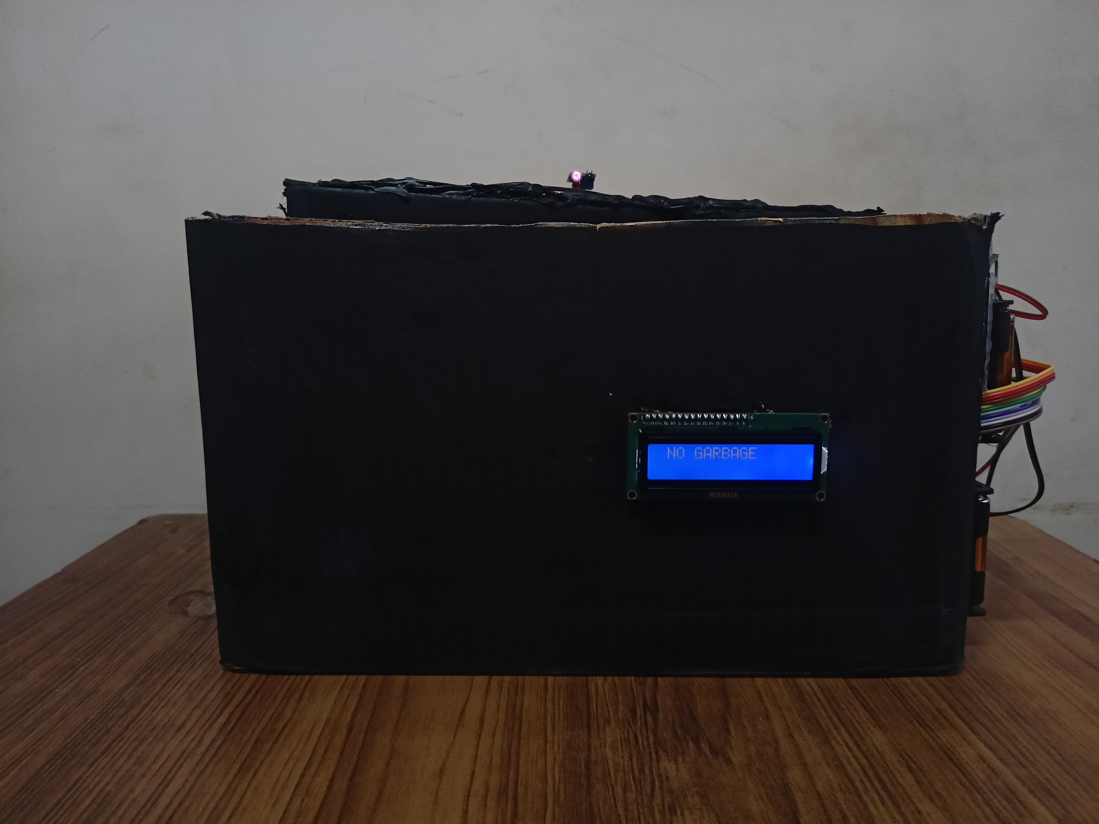
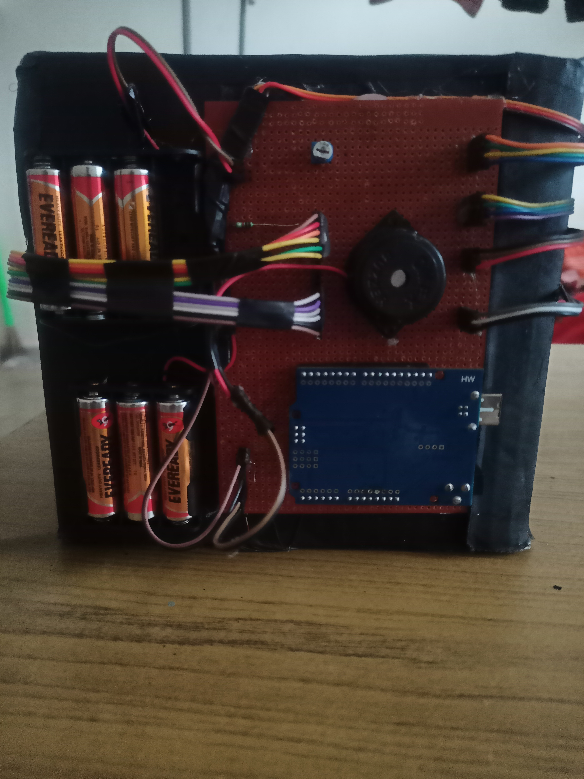
result
Every component as explained earlier is interfaced with Arduino UNO microcontroller.
We use Arduino ide software to program this system and results are found to be accurate.
Accurately detecting the type of waste as it is put in the dustbin and dumping it into corresponding slots.
Dry waste segregation
Wet waste segregation
Fig 13: Setup of the whole system
Fig 14: Dry Waste Segregation.
Fig 15: Wet Waste Segregation.

Slide 22
Conclusion
Implementation of this system at a local level like societies, educational institutes, etc. can reduce the burden on the local authorities. The waste segregator is one small step towards building an efficient and economic waste collection system with a minimum amount of human intervention and also no hazard to human life. Segregating all these wastes at a domestic level will also be time-saving. While implementing our system we came across many problems like the sensing range of inductive proximity sensor, the accuracy of the moisture sensor, adjusting the range of IR sensors and some more, but using some modifications we tried the make the system as reliable as possible but not completely perfect. The garbage monitoring and controlling with smart segregation of dry and wet waste system using Arduino Uno is a promising new technology that has the potential to make a significant impact on waste management in urban areas.

Slide 23
references
[1] Amrutha Chandramohan, Joyal Mendonca, Nikhil Ravi Shankar ‘Automated Waste Segregator’ Texas Instruments India Educators' Conference (TIIEC), CA, vol. 1, no. 1–3, pp. 41–51, May 2014
[2] Poorani Ravindhiran, Pradeep Gopal, Joseph Gladwin S, Rajavel R ‘Automated Indoor Waste Management System Employing Wave Front Algorithm and Received Signal’ IEEE Trans. Communications, vol. 1, no. 5, pp. 26 –33, Nov 2017
[3] Smita S Pawar, Shivani Pise, Kranti Walke, Renuka Mohite ‘Smart Garbage Monitoring System Using AVR Microcontroller’ Fourth International Conference on Computing Communication Control and Automation (ICCUBEA), India, vol. 3, no. 1, pp. 83–100, Feb 2018

Slide 24
Course Outcomes
On completion of this course, we are able to:
Solve the identification problems.
Analyze the available resources and their utilization.
Present the work carried out and prepare the report.
Work in a team to find the solution for societal and technical problems.

Slide 25
THANK YOU

